Slide 1
RetinalScan AI
AI-Based Retinal Disease Screening System
Diabetic Retinopathy · Hypertensive Retinopathy · Glaucoma
Sprint 4 of 5 Complete
Muhammad Arsal Saeed
Mashal Areej

Slide 2







Technology stack
Every component chosen for maximum result at minimum cost — total recurring cost: $0
Data preprocessing
OpenCV · NumPy
Black border crop · CLAHE contrast · resize 224×224 · normalization · augmentation on train set
Model training
PyTorch (from scratch)
Custom 5-block CNN for diabetic retinopathy · Custom U-Net for glaucoma segmentation · zero pretrained weights
Model export
ONNX opset 18
Single self-contained portable file · runs anywhere
Backend
Node.js · Express · onnxruntime-node
CPU-only inference · no GPU at clinic · Multer for uploads · Sharp for server-side image preprocessing · Local clinics can use easily
Frontend
Plain HTML · CSS · JavaScript
Clinical UI · jsPDF for structured A4 report · works in any browser · no framework, no install
Training compute
Kaggle / ColabT4 GPU
Checkpoints every 5 epochs

Slide 3


What we have built so far
Every component below is written, tested, and working end to end
Sprint 1-3
Data pipeline
DR model (CNN)
Glaucoma model (U-Net)
Python
1.7M parameters
REFUGE
94,000 fundus images merged from APTOS, EyePACS & REFUGE· OpenCV preprocessing · CLAHE
5-block CNN from scratch in PyTorch · No pretrained weights · 75.29% val accuracy on APTOS
U-Net trained 50 epochs · Dice Disk Acc. 93.91% · Dice Cup Acc. 83.43% · Average CDR error ~ 0.24
Node.js backend
Clinical UI & PDF report export
ONNX export
Express + onnxruntime
Plain HTML/CSS/JS + jsPDF
opset 18
Accepts image uploads · preprocesses with Sharp · runs ONNX inference · returns JSON prediction
Patient form · drag-and-drop upload · diagnosis hero · risk meter · probability table · Structured A4 report
Single self-contained file · no external data · confirmed loads in Node.js

Slide 4
What we have built so far
Every component below is written, tested, and working end to end
Sprint 1-3
HR Model
Image Quality Gate
Grad-CAM Heatmap
RetinalCNN
Python
Python microservice
~ 2000 images merged from two datasets · OpenCV preprocessing · CLAHE · 5 conv blocks
Rejects non-fundus images· Blur Detection · Circular retina detection
Runs alongside Express · For DR only · Generates a heatmap of model detection

Slide 5

Training progress and results
Diabetic Retinopathy Model
Glaucoma Segmentation Model
Custom CNN · from scratch · PyTorch
Custom U-Net · from scratch · PyTorch ·
Architecture
5 conv blocks · BatchNorm · ReLU · MaxPool · 1.7M parameters
Encoder-decoder · skip connections · 2-channel mask output
Architecture
Training data
APTOS 2019 + EyePACS · 91,630 total images merged
ORIGA + REFUGE + G1020 · ~2,870 fundus images with masks
Training data
Class weighting
Applied, CrossEntropyLoss weighted by frequency
Pixel-level optic disc and cup segmentation masks
Output
Optimizer
Adam · learning rate 0.001 · scheduler on plateau
Cup area ÷ Disc area → glaucoma risk classification
CDR calculation
Best val accuracy
75.29%
Best Val Accuracy
93.2%
Val loss trend
1.5987 → 1.125 across 30 epochs
0.589 → 0.1236 across 50 epochs
Val Loss Trend
ONNX export
Confirmed · opset 18 · single file · deployed in backend
Same pipeline as DR model
ONNX export
Status
Done for now · can be improved in the future with more data
Done for now · can be improved in the future with more data
Status

Slide 6
Training progress and results
Hypertensive Retinopathy Model
Custom CNN · from scratch · PyTorch
Architecture
retinalCNN reused · 5 Conv Blocks
Training data
Zoya77 + HRDC HR + EyePACS ~2000 images
Output
HR not detected/detected (0/1)
Training Config
50 epochs · Adam LR 0.001
Best Val Accuracy
71.72% · Sens 95% · Spec ~43%
0.7456 → 0.600 across 50 epochs
Val Loss Trend
Same pipeline as DR model
ONNX export
Done for now · can be improved in the future with more data
Status

Slide 7
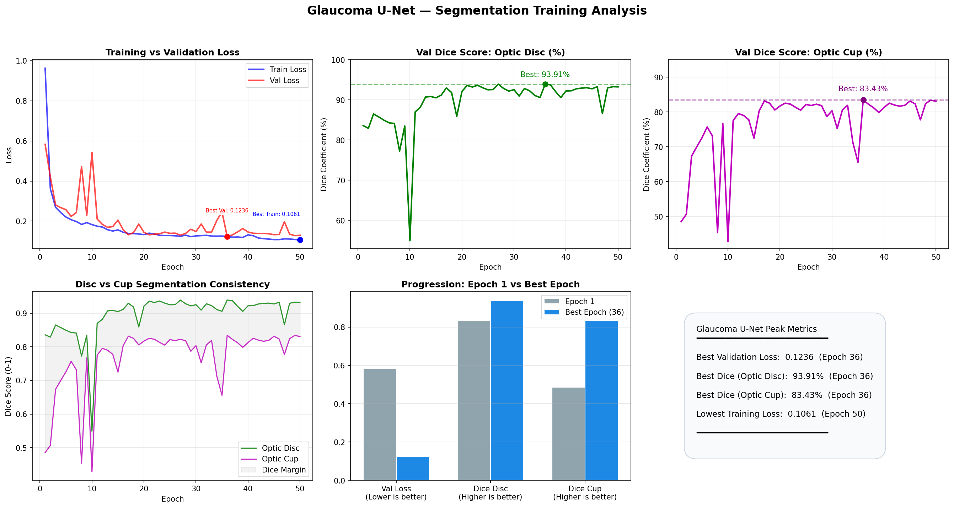

Slide 8
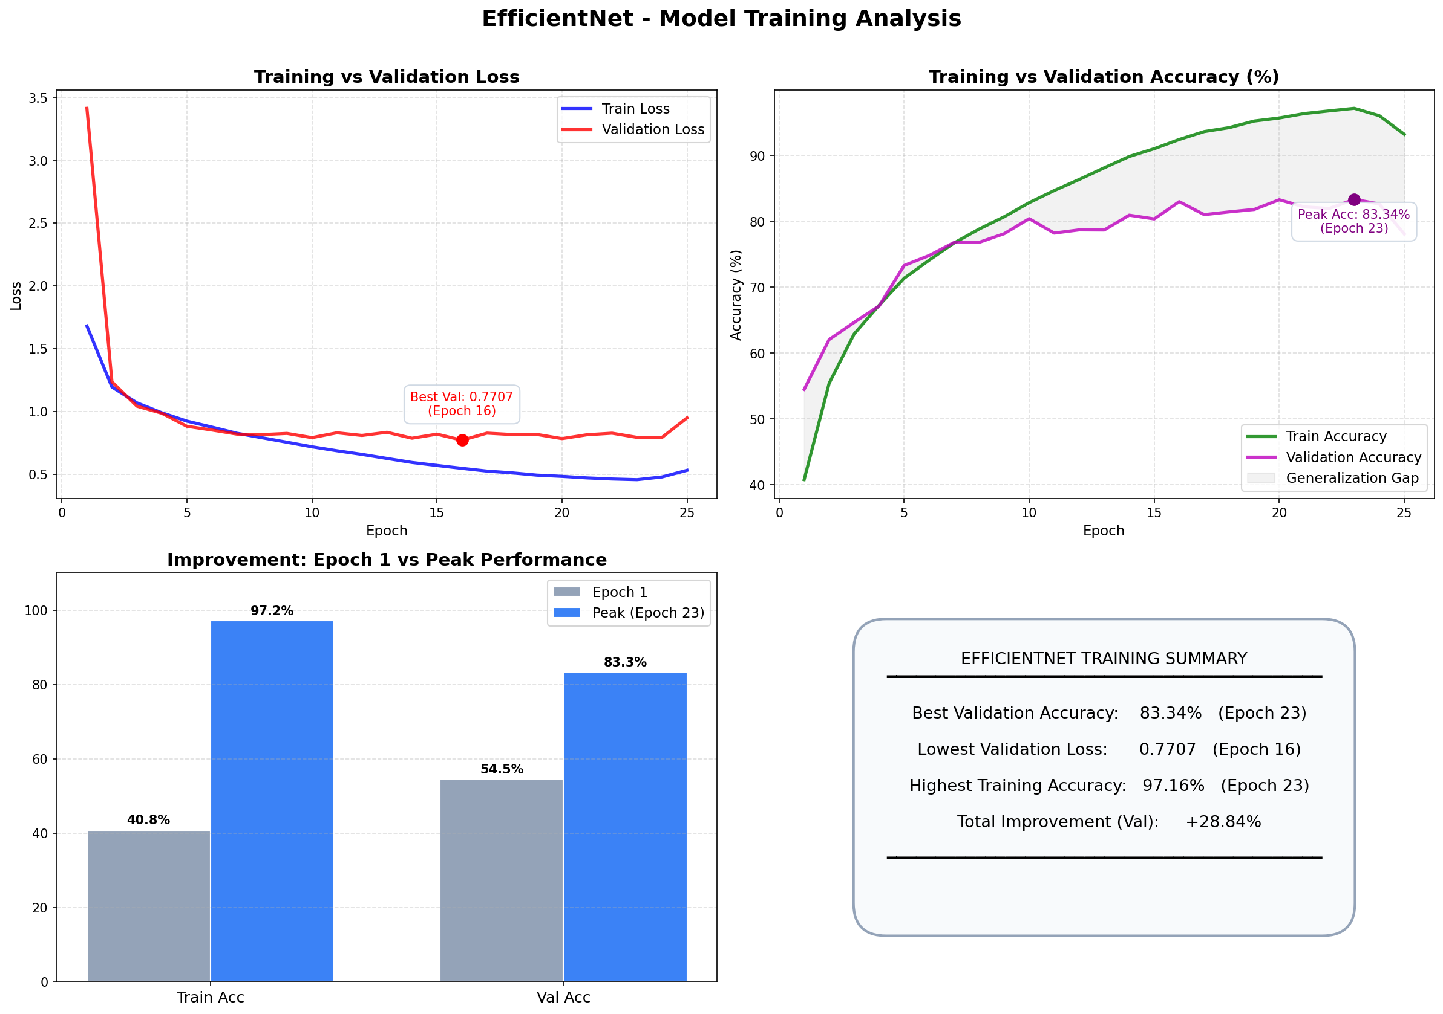

Slide 9
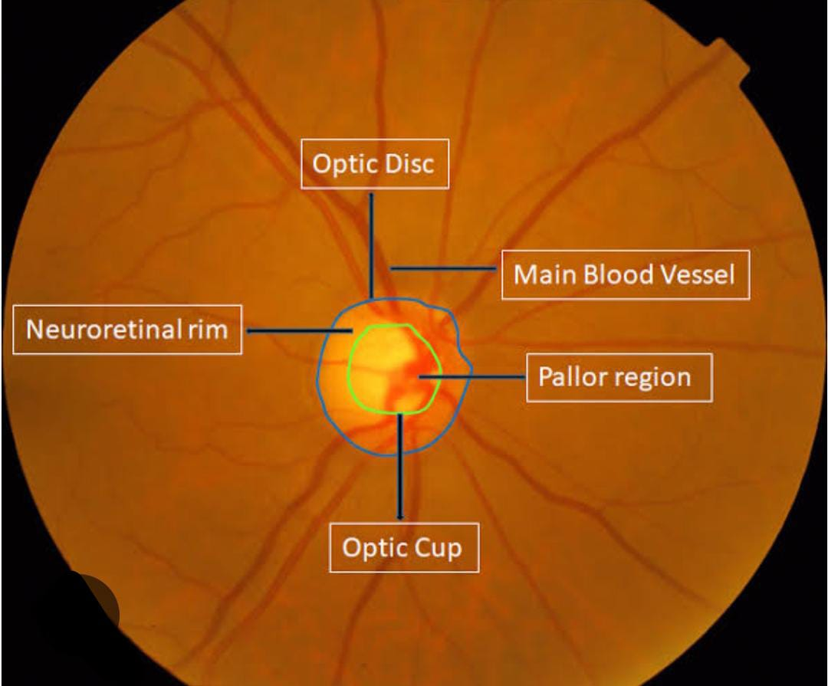
Behind the scenes of CDR Ratio
CDR > 0.6 is fatal

Slide 10

Remaining 1-Sprint delivery plan
Sprint 4 done · 1 to go · full working system delivered by end of Sprint 5
✓ Sprint 4 complete — data pipeline · All 3 models · Grad-CAM · Image gate · ONNX export · Node backend · clinical UI · PDF report all working
✓
✓
✓
Sprint 2
Sprint 3
Sprint 4
Sprint 5
• Scout Hypertensive Retinopathy Datasets over the internet
• Re-polish the Frontend UI
• First end-to-end test with real fundus images
• Final testing on held-out images all conditions
• Train HR Model on Hypertensive Retinopathy dataset
• Run Dice score validation on REFUGE
• Fix edge cases, blurry images, and borderline predictions
• Write the documentation, final accuracy report
• Export HR model to ONNX format
• Test HR model on held out images
• Measure sensitivity, specificity, and AUC for both models
• Prepare client demo with live system walkthrough and presentation
• Add /predict-hr endpoint and HR results to frontend
• Add image quality gate to all predict routes
• Dockerise the Node.js backend
• Final code cleanup, and deployment
• Grad-CAM heatmap implementation
• Retrain all models if required
• Project handover

Slide 11
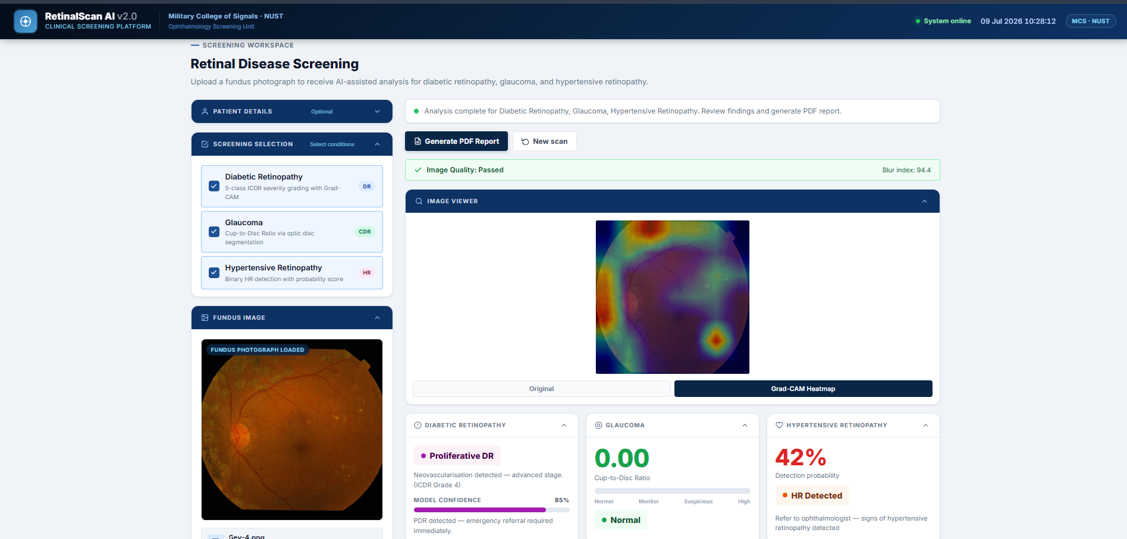
System Interface

Slide 12
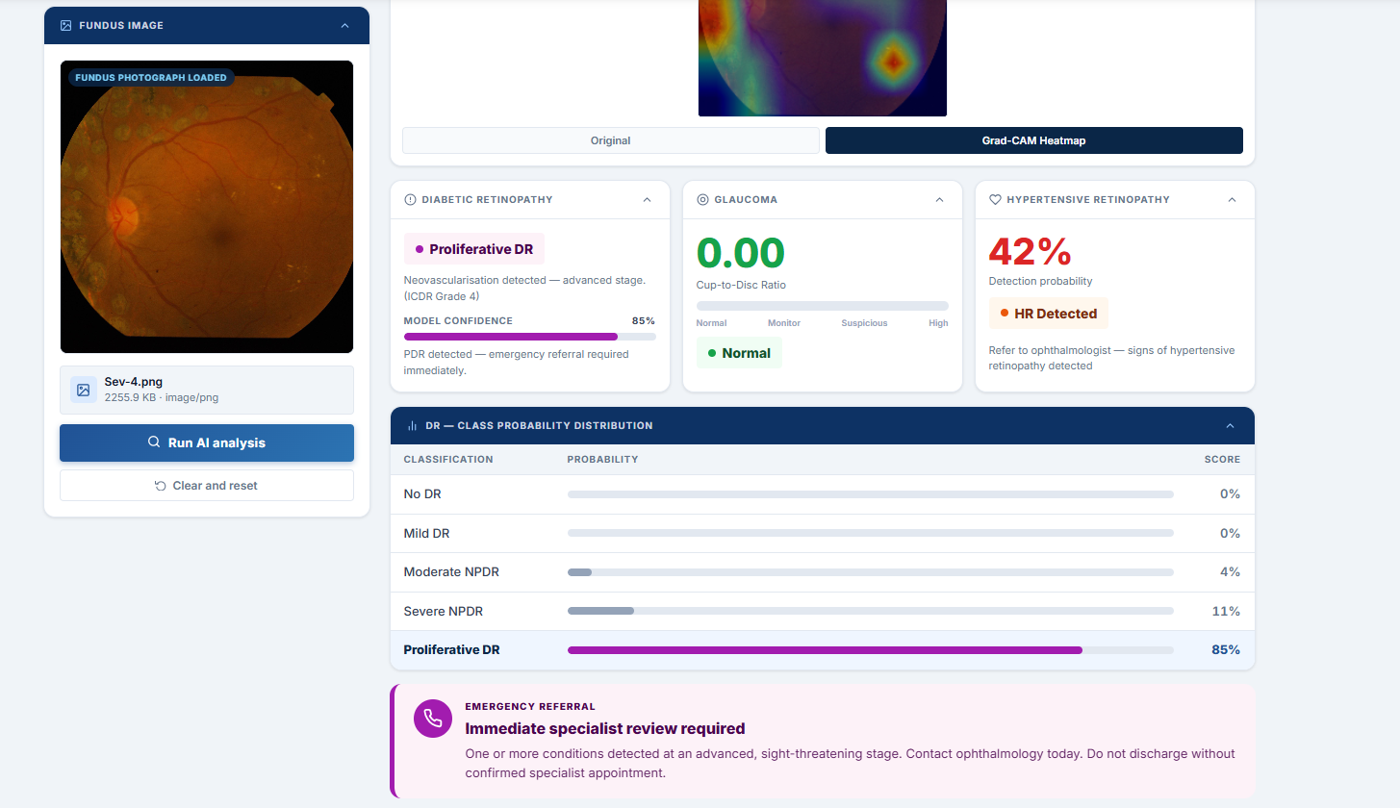

System interface - Analysis result
Full clinical result returned in under 2 seconds on CPU — no GPU at the clinic
Diagnosis badge
Color coded by severity — green for No DR
Model confidence
63% confidence on top class
Risk level meter
Visual bar from Minimal to Critical
Referral guidance
Re-screen in 12 months — actionable text
Probability table
All 5 classes with bar and score
Scan metadata
Scan ID, date, model, dataset, institution

Slide 13
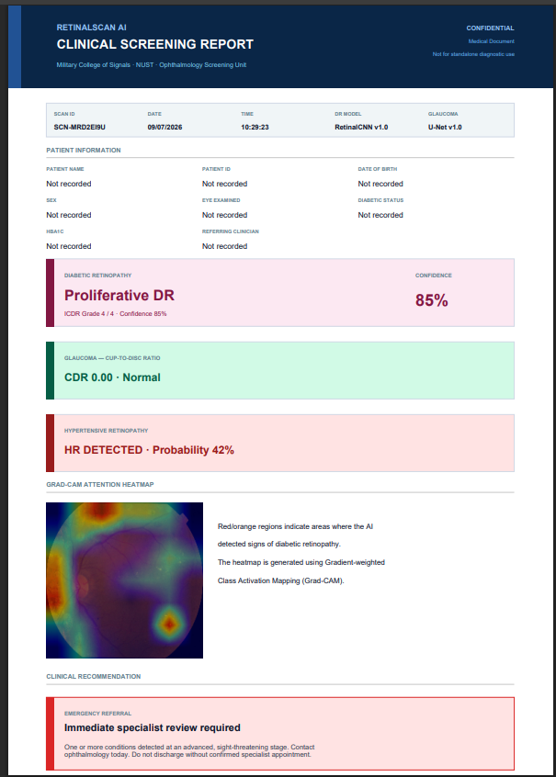
PDF clinical report
Exported as a structured A4 document using jsPDF
Header
Navy bar · RETINALSCAN AI branding · CONFIDENTIAL tag · Not for standalone diagnostic use
Scan metadata
Scan ID · Date · Time · Model version · Dataset used — all auto-filled from the session
Patient information
Name · Patient ID · Age · Eye examined · Referring clinician — pulled from the form
Diagnosis box
Color-coded by severity · Primary diagnosis in large type · ICDR Grade · Confidence percentage
Referral recommendation
Clinical action text based on ICDR guidelines · urgency level stated explicitly
Probability table
All 5 classes with inline bar charts · highlighted top class · percentage scores
Disclaimer + footer
Full clinical disclaimer · institution name · page number · cannot be used as standalone diagnosis

Slide 14
W1
W2
W3
W4
W5
Week 4 of 5 complete
1 week remaining
One photo.
Three conditions.
Any clinic.

